Slide 1


Quality Control and Defect Management in Manufacturing
Maria Toledo
DSC 680
January 18, 2026
Notes:
Today I’ll be presenting my analysis on Quality Control and Defect Management in Manufacturing. This project explores how defects occur, how they are detected, and how analytics can help reduce costs and improve inspection effectiveness.

Slide 2


Introduction
A manufacturing defect is defined as a flaw that occurs during the production or assembly of a product.
Manufacturing defects increase repair costs, delay production, and reduce customer satisfaction.
U.S. companies paid $55.3M in fines in 2023 due to defects.
Effective defect management reduces operational and financial risk.
Quality Control identifies potential defects before they become an issue.
Inspection methods include Visual, Manual, and Automated.
Severity levels can be Minor, Moderate, or Critical.
Critical defects have 0% tolerance due to safety risks
Notes:
Manufacturing defects create significant operational and financial challenges. They increase repair costs, slow down production, and impact customer satisfaction. In 2023, U.S. companies paid over 55 million dollars in fines related to manufacturing defects. My goal in this project was to understand defect patterns and identify ways to improve detection and reduce risk. Quality Control focuses on identifying defects before products reach customers. Defects are detected through three inspection methods: visual, manual, and automated. Defects are also classified by severity: minor, moderate, and critical. Critical defects are the most serious and have zero tolerance because they are likely to cause safety issues to employees or customers.

Slide 3

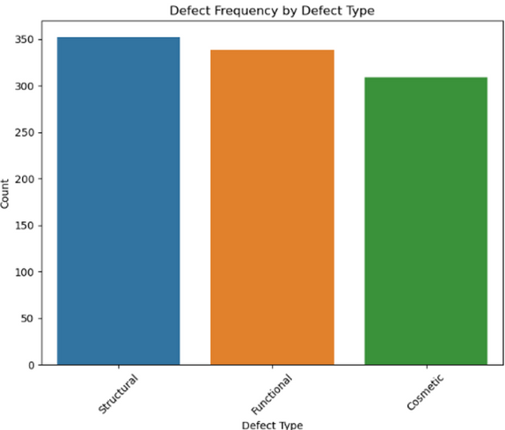
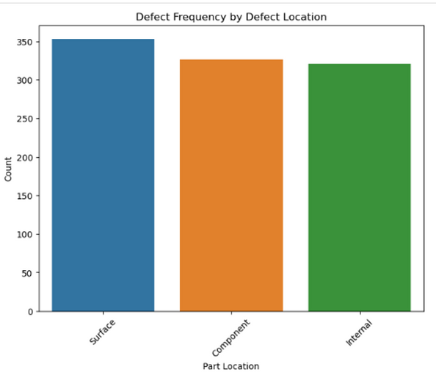
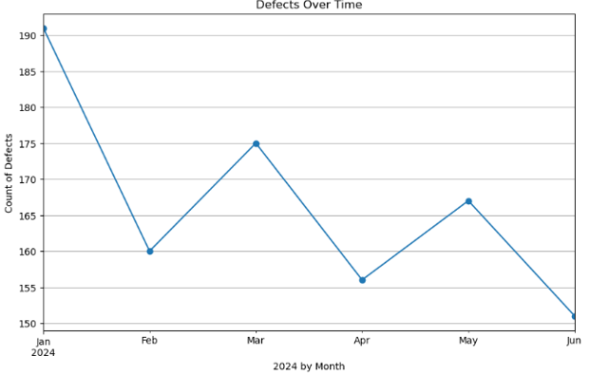
Dataset Overview and Findings
Source: Kaggle (simulated quality control dataset)
Categories include defect type, date, location, severity, inspection method, repair action, and repair cost
Preparation methods done include one-hot encoding for categorical variables and label encoding for severity.
Goal is to understand patterns, predict severity, and recommend inspection strategies
Defects are evenly distributed across defect types.
Defect locations (surface, component, internal) show similar frequencies.
January had the highest defect count; June had the lowest.
Notes:
The dataset comes from Kaggle and includes simulated quality control records. It contains information about defect type, defect location, severity, inspection method, and repair cost. I performed preprocessing using one hot encoding and label encoding. The goal was to explore patterns, build predictive models, and recommend the most effective inspection strategies.
From the descriptive analysis, we see that defect types and defect locations are fairly evenly distributed. When we look at defects over time, January had the highest number of defects while June had the lowest. These patterns help us understand when and where defects tend to occur.

Slide 4

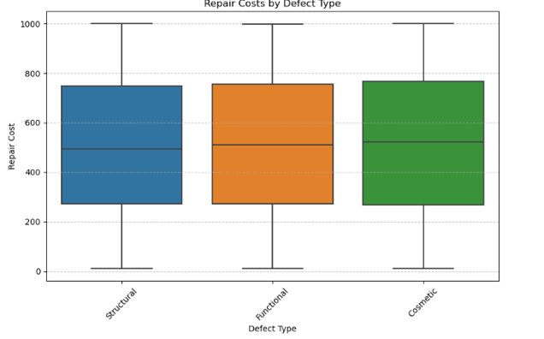
Repair Cost Analysis
Overall repair costs are similar across defect types
Cosmetic defects show slightly higher repair costs
Notes:
The boxplot shows that repair costs are fairly similar across defect types, with cosmetic defects being slightly more expensive on average.

Slide 5

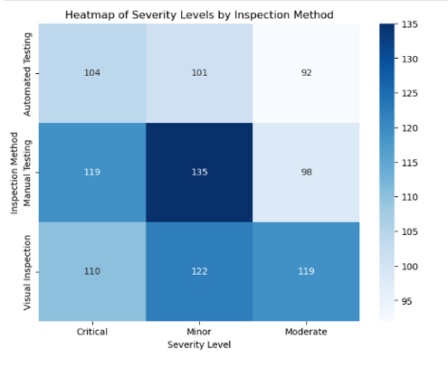

Severity vs. Inspection Method
Manual testing detects the most Minor defects
Automated testing rarely detects Moderate defects
Visual inspection is consistently the least effective
Inspection method strongly influences severity detected
Notes:
The heatmap reveals some important insights. Manual testing detects the most minor defects. Automated testing rarely detects moderate defects, which may indicate sensitivity issues. Visual inspection consistently performs the worst across all severity levels. This tells us that inspection method choice directly affects the severity levels we detect.

Slide 6
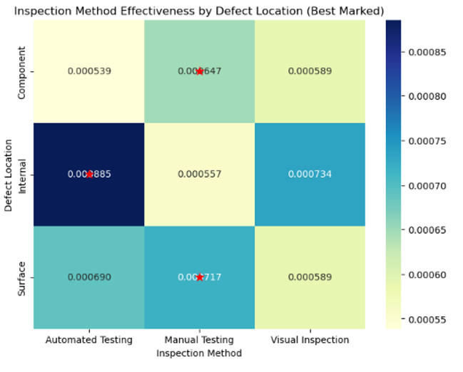
Reccomendations and Ethical Considerations
Recommendations from analysis:
Manual testing → best for surface and component defects
Automated testing → best for internal defects
Visual inspection → lowest effectiveness
Assign inspection methods based on defect location
Reduce reliance on visual inspection
Collect more balanced data on critical defects
Explore real‑time detection using sensors
Ethical Considerations:
Do not use defect data to blame workers
Protect product and employee identifiers
Ensure fairness in defect classification
Maintain transparency in model decisions
Notes:
Using the heatmap, I identified which inspection methods work best for each defect location. Manual testing is most effective for surface and component defects.
Automated testing is best for internal defects.
Visual inspection consistently underperforms and should be used less frequently.
Additional Recommendations would then include to :
Assign inspection methods based on defect location
Reduce reliance on visual inspection
Collect more balanced data on critical defects
Explore real‑time detection using sensors
Ethical considerations
It’s important to use defect data responsibly. The data should never be used to blame workers. Product and employee identifiers must be protected. The model should be monitored for fairness, and decisions should remain transparent so stakeholders understand how classifications are made.

Slide 7

Implementation Plan and Future Applications
Phase 1
Deploy model in a pilot environment and train Quality Control employees
Optimize inspection assignments
Ongoing monitoring and governance
Phase 2
Collect new data & retrain models
Integrate IoT sensors for real‑time detection
Improve repair cost prediction with advanced models
Notes:
The implementation plan includes two phases.
First, deploy the model in a pilot environment. Optimize inspection assignments based on the findings. And finally, continuously monitor performance and update the models as needed.
Second, collect new data and retrain the models, and integrate real-time detection using sensors. More advanced models could also improve repair cost prediction.

Slide 8
Audience Questions
What are the most common defect types?
All defect types occur at similar frequencies, with no single type dominating. Cosmetic defects appear slightly more often, but overall distribution is balanced.
Which inspection methods detect each severity level most effectively?
Manual inspection detects the most Minor defects.
Automated inspection is strongest at detecting Critical and Internal defects.
Visual inspection is the least effective across all severity levels.
How does inspection effectiveness vary by defect location?
Manual is most effective for Surface and Component defects.
Automated is most effective for Internal defects.
Visual underperforms for all locations.
Are certain defect types more likely to be critical?
Internal structural defects show a higher likelihood of being Critical, while cosmetic and surface‑level defects tend to be Minor or Moderate.
Which defect types are most costly?
Cosmetic defects show slightly higher average repair costs.
Does severity impact repair cost?
Higher severity levels are associated with higher repair costs, although the relationship is not perfectly linear.
Are there seasonal trends in defect occurrence?
January shows the highest defect count and June the lowest.
Do certain defect locations show higher defect rates?
Surface and Component defects appear slightly more frequently than Internal defects.
Does inspection method influence severity detected?
The inspection method strongly affects which severity levels are found.
Manual → more Minor defects
Automated → more Critical defects
Visual → lowest detection across all severities
How accurately can repair costs be predicted?
Linear Regression performed poorly (RMSE ≈ 294), indicating non‑linear patterns.
Overall, repair cost prediction is moderately accurate, but could improve with more features.

Slide 9
Thank
You!

